Slide 1
Health Information System
A Prototype Demonstration
Paul Wanyoike Ngugi
April 26, 2025

Slide 2
Introduction
Task - Develop a basic health information system.
Problem - Managing client data and program enrollment in healthcare settings.
Goal - To create a functional prototype that meets the core requirements.

Slide 3
Understanding the Task
Core requirements from the task document
Create health programs.
Register new clients.
Enroll clients in programs.
Search for clients.
View client profiles.
Expose client profile via API.

Slide 4
Technology Stack
Node.js: "JavaScript runtime for building the server-side application."
Express: "Web framework for creating the API."
SQLite: "Lightweight database for storing data."
Joi: "Data validation library to ensure data integrity."
Validator: "Input sanitization library to prevent SQL injection."
express-basic-auth: "Basic authentication library to secure API endpoints."

Slide 5
Code Structure - app.js
Single file containing all application logic.
Includes:
Express server setup and routing
SQLite database initialization and queries
API endpoint definitions
Authentication middleware
Error handling middleware
Data Validation
The app.js contains the logic and is structured in an orderly fashion.

Slide 6
Database Schema
Database tables and their relationships:
programs (id, name)
clients (id, name, dob)
client_programs (clientId, programId)
users (id, username, password)

Slide 7
API Endpoints
POST /programs: "Create a new health program (id, name)."
POST /clients: "Register a new client (id, name, dob)."
POST /clients/:clientId/enroll: "Enroll a client in a program (programId).”

Slide 8
API Endpoints
GET /clients: "Search for clients (query parameter)."
GET /clients/:clientId: "View a client's profile (id, name, dob, programs)."

Slide 9
Security Measures
Basic Authentication: "Implemented to protect API endpoints. Use 'admin' and 'secret' credentials."
Input Sanitization: "Used to prevent SQL injection attacks. Uses the 'validator' Library"

Slide 10
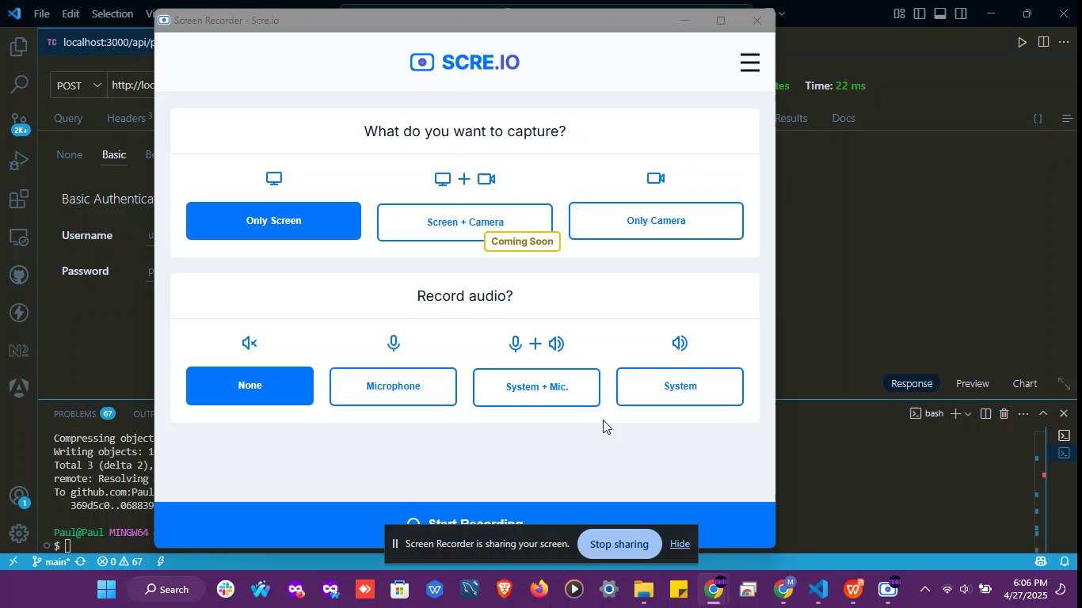
Live Demo

Slide 11
Challenges and Solutions
Database setup and schema design: "Ensuring proper relationships between tables."
Data validation: "Implementing robust validation to prevent errors."

Slide 12
Potential Improvements
JWT-based authentication: "For enhanced security and scalability."
Automated testing: "To ensure code quality and prevent regressions."
API documentation (Swagger): "To improve usability and integration."
Deployment to a cloud platform: "For scalability and reliability."

Slide 13
Conclusion
Key Features & Accomplishments:
Developed a basic health information system supporting health program creation, client registration, enrollment, search, and profile viewing.
Exposed all core functionalities through a clean, well-documented API.
Implemented data validation, input sanitization, and basic authentication for security.

Slide 14
Conclusion
Core Requirements Met:
Fully addressed all functional requirements outlined in the task, ensuring usability and clarity.
Delivered clean code, clear documentation, and a working prototype as specified.

Slide 15
Thank You
Thank you for your attention and the opportunity to present my solution.

Slide 16
Questions
Any Questions?

